Slide 1
From Retro Classics to Modern Software
Emulation's Evolving Role in Computing
Mike Ravenelle - Nebraska.Code() 2023

Slide 2
Mike Ravenelle
Senior Software Engineer - Bosch
Graduated high school from Norfolk, NE
Computer Science - University of Nebraska
Worked at Bosch since 2015
Telex Radio Dispatch Products
RTS Intercom Products
Currently looking for a entry/mid level Software Engineer

Slide 3
What is emulation?

Slide 4
What is emulation?
What is it used for?
Imitation
Legacy software and hardware
Testing an debugging
Video Games
Preservation
It is estimated 87% of retro games are lost to time

Slide 5
What is emulation?
How does it work?
Creation of a virtual environment
Replication of system features and functions
Interpretation of target system on host
Bridges target to host

Slide 6
What is emulation?
Why do I care?
Its cool?
Legacy support
Preservation
Obsolete Hardware
Video Games

Slide 7
Are emulators legal?

Slide 8
100%
Emulation as a concept is legal

Slide 9
100%
Not a lawyer

Slide 10
What is emulation?
Legal Disclaimer
Emulation itself is a legal concept
Reverse engineering is typically legal “clean room”
Pirated copyright ROMs, ISO’s, etc. ARE NOT
Personal use of emulated backups is typically permitted

Slide 11
“The court ruled in favor of Bleem, stating that the emulator did not infringe on Sony's copyright and had a legitimate purpose.”
Sony Computer Entertainment America, Inc. v. Bleem, LLC (2001)

Slide 12
“The court ruled in favor of Accolade, stating that reverse engineering was permissible under fair use as long as it was for compatibility purposes”
Sega Enterprises Ltd. v. Accolade, Inc. (1992)

Slide 13
“The court ruled in favor of Connectix, stating that the emulator did not violate Sony's copyright because it required users to have their own PlayStation BIOS”
Sony Computer Entertainment America Inc. v. Connectix Corporation (2000):

Slide 14
Modern Use Cases

Slide 15
Modern Use Cases
Rosetta 2
Apple’s emulation technology for M1/M2 products
x86 application support on ARM processors
Allows x86 compiled applications to run on ARM
Seamless Compatibility
Minimal user input to function
No changes needed by developers
Some applications are even faster than on equivalent x86 hardware

Slide 16
Modern Use Cases
WOW64
Microsoft’s compatibility layer for x86 -> ARM
Not an emulator
Utilizes a combination of translation and redirection techniques
Does not require specific hardware
Generally not as efficient

Slide 17
Modern Use Cases
Video Game Emulators
Dolphin
Gamecube emulator
Cemu
Wii U emulator
Ryujinx and Yuzu
Switch emulators

Slide 18
Modern Use Cases
Video Game Emulators
PPSSPP
PSP emulator
PCSX2
PS2 emulator
RPCS3
PS3 emulator

Slide 19
Modern Use Cases
How this effects you?
Legacy support
Supporting new hardware
Being aware
Designing and compiling
Testing
Performance impact
Emulation and Virtualization
QEMU

Slide 20
The ARM Revolution

Slide 21
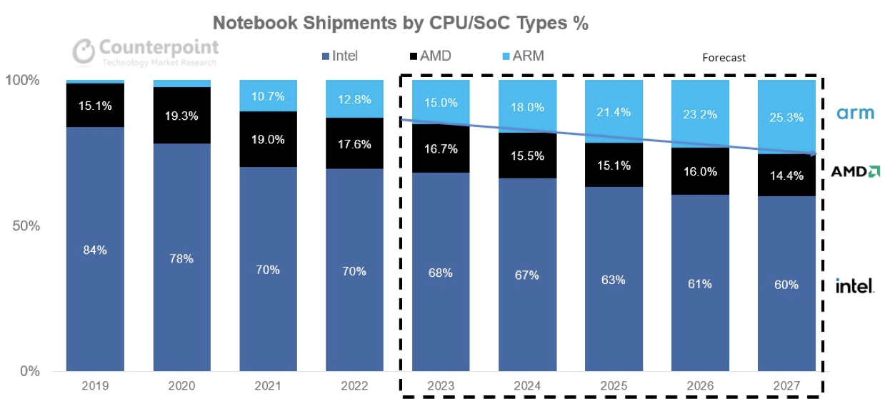
ARM Revolution
Notebook marketshare
https://www.counterpointresearch.com/arm-based-pcs-to-nearly-double-market-share-by-2027/

Slide 22
ARM Revolution
Current landscape
x86 pure dominance
ARM is disruptive
Mobile
Power efficiency
Scalability
ARM ecosystem of chip manufacturers
ARM is a licensed architecture

Slide 23
“ARM-Based Servers Market Revenue To Grow Rapidly With US$ 16,714.6 Mn by 2032”
https://www.globenewswire.com/en/news-release/2022/08/25/2504300/0/en/ARM-Based-Servers-Market-Revenue-To-Grow-Rapidly-With-US-16-714-6-Mn-by-2032-Future-Market-Insights-Inc.html

Slide 24
Why ARM?

Slide 25
ARM Revolution
Why ARM?
Significantly less power
RISC
Simplified instructions
Performance per watt
IoT and Mobile Dominance
Multiple players in ARM not just two(AMD/Intel)
Scalability
From embedded devices to server grade hardware

Slide 26
ARM Revolution
Server space
Aimed at cloud computing
Low power == less heat == less cooling
Multiple vendors
NVIDIA
Amazon
Marvel
Huawei
Ampere

Slide 27
ARM Revolution
Consumer space(Apple)
M1/M2 Product line
Low power draw
High performance
Rosetta 2
Apple controls silicon -> software

Slide 28
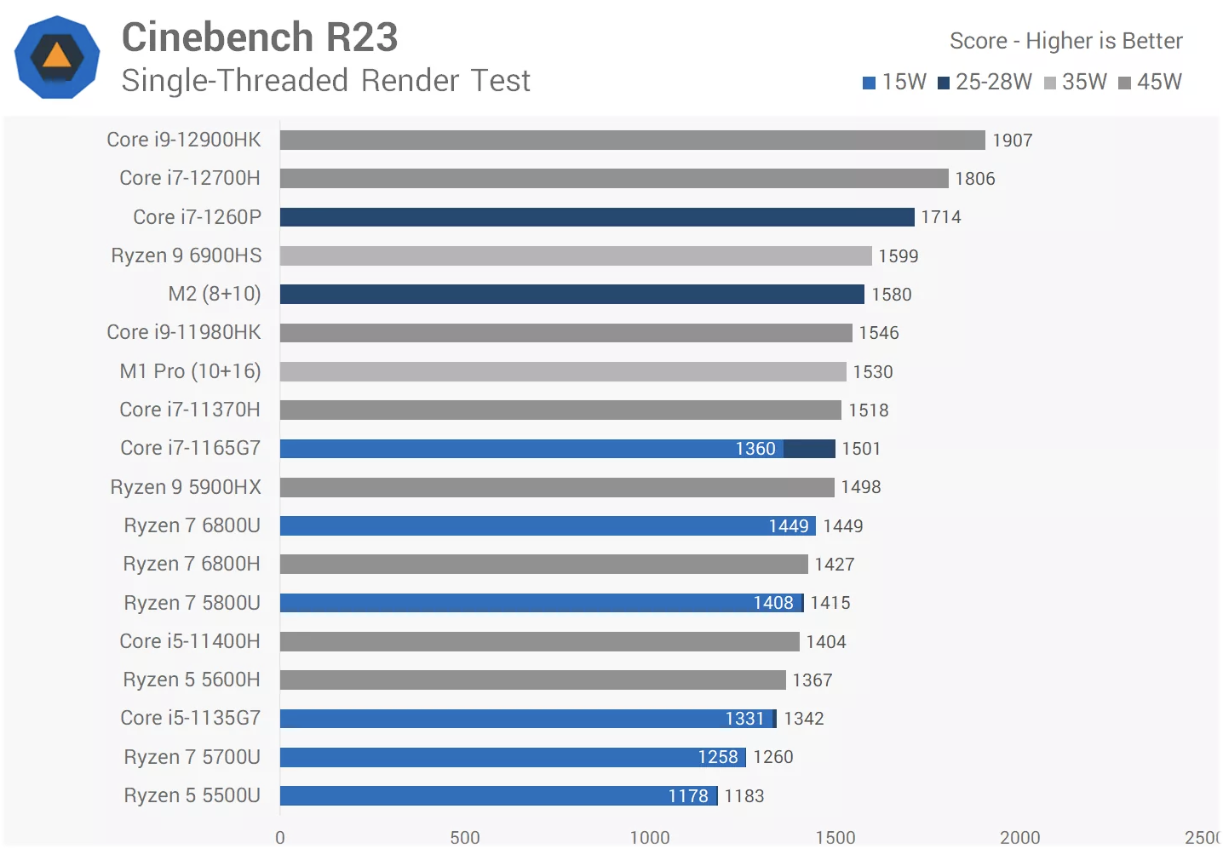
https://www.techspot.com/review/2499-apple-m2/

Slide 29
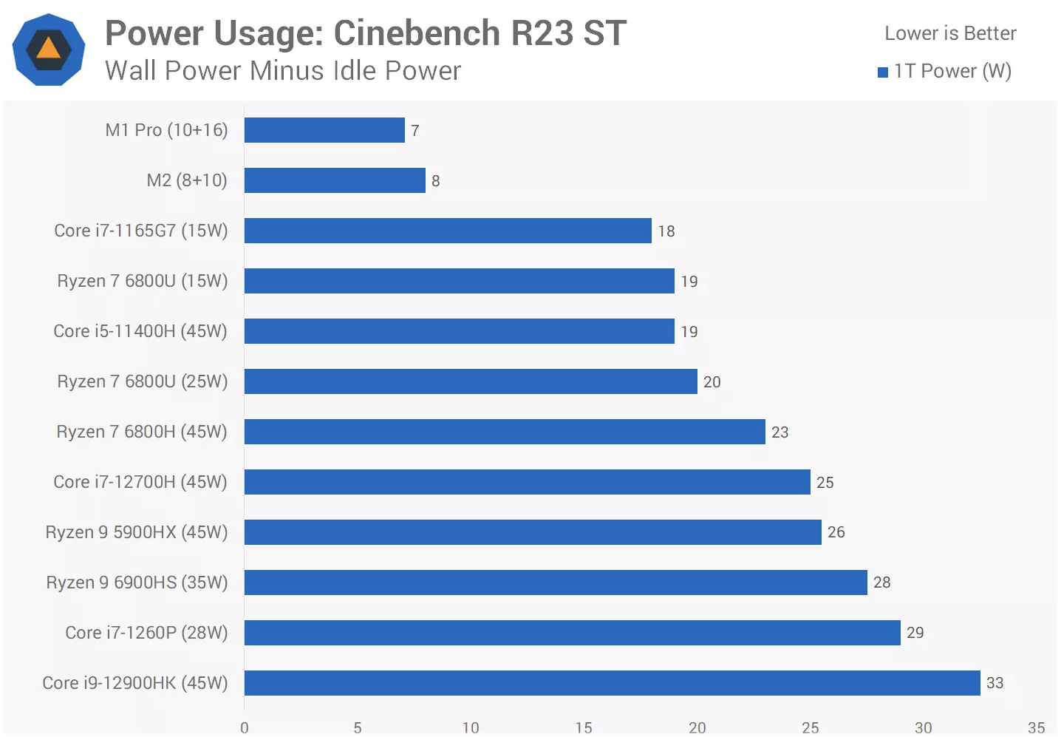
https://www.techspot.com/review/2499-apple-m2/

Slide 30
ARM Revolution
Consumer space(Windows)
Low power mobile laptops
Lenevo Yoga
Samsung Galaxy Book S
HP Envy x2 and HP Elite Folio
Microsoft Surface
All use Qualcomm ARM CPU’s
Not entirely fair to compare to M1/M2

Slide 31
Emulation Demo

Slide 32
Emulation Demo
Rosetta 2 and RPCS3
Rosetta 2 is best real world example to demo
RPCS3 emulates the PS3
Sony CELL(PowerPC) CPU
RSX(NVIDIA G70 (previously known as NV47) architecture)
CELL(PowerPC) -> x86 -> ARM

Slide 33
Emulation Demo
Rosetta 2 and RPCS3
Demon Souls
Average power usage:
~11w CPU
~1w GPU
Average frame-rate:
30fps(game is limited to 30fps)
Average PS3 power usage:
170w to 200w(90nm CELL)
120w to 140w(65nm CELL)

Slide 34
So… why do I care?

Slide 35
Why do I care?
How does it effect me?
Being aware of possible layers when debugging issues
Basic understanding of how those layers work
Testing ahead of time
Consideration during development
Allows for not recompiling code and adding additional testing
Being aware of trends in industry

Slide 36
Emulators how do they work?

Slide 37
Emulators how do they work?
Types of emulation
Interpreters
Direct execution of instructions
AoT
Ahead of time compilation
JIT
Just in time compilation

Slide 38
Emulators how do they work?
Interpreters
Works by executing target binary line by line
Typically easier development (there are exceptions)
Slower than other methods
Limited available optimization

Slide 39
Emulators how do they work?
AoT
Also known as static binary translation
Works by translating entire binary ahead of time
Output runs natively after translation
Allows for improved performance
Upfront cost and involved process

Slide 40
Emulators how do they work?
JIT
Also known as dynamic binary translation
Combines elements of interpretation and compilation
On the fly compilation
Allows for improved performance
Caches translated code
Best balance
Highest complexity

Slide 41
What has to be emulated?

Slide 42
What all has to be emulated?
CPU
Registers
Replicate CPU’s registers found within its architecture
General purpose registers
Special-purpose registers
Index Registers (address registers)
Program Counter
Stack
Data
Subroutines calls and routines

Slide 43
What all has to be emulated?
Memory
Virtual representation of memory system
Emulating address space
Operations
Read
Write
Permissions

Slide 44
What all has to be emulated?
GPU
Shader Cores
Memory Hierarchy
Texture Units
Rasterization Pipelines
Frame Buffers
Command and Control Processors
API’s (DirectX, OpenGL, etc.)

Slide 45
It’s a dark dark place…

Slide 46
GPU’s are hard…

Slide 47
What all has to be emulated?
Sound
HLE
Uses DSP engine made by the developer by studying the real DSP
Can be faster but can have errors
LLE
Developer created DSP that emulates DSP hardware behavior
Typically slower but can be more accurate
DSP ROM
Best of both worlds!
Has to be extracted from original hardware and can not be shared(copyright)

Slide 48
What all has to be emulated?
Fonts
Fonts used on system have to be emulated
Most fonts are proprietary
Typically try to use an open font that is similar

Slide 49
What all has to be emulated?
Input
Input can vary depending on system that your are emulating
Keyboards
Mice
Gamepads
Requires knowledge on interface to translate to host system input
For example: XInput -> PS3 controller translation

Slide 50
So you want to write your own emulator?

Slide 51
So you want to write your own emulator?
Why?
Learning experience
Gain a deep understanding of a computer system
Personal challenge
Complex task that is rewarding
Education resource
Shareable knowledge

Slide 52
…and then there was Chip8

Slide 53
Chip8 Emulator
Coding Example
Will not make you a emulation expert!
But can show how in general, emulation works
Glimpse into a interpreter emulator
Has general emulation principles

Slide 54
Chip8 Emulator
What we need to emulate
CPU
Program Counter (PC)
Index Register(16bit register)
General and Special Registers
Memory
4 Kb
4096 bytes
PC can only address 12 bits, allows for 4096 address(2^12)

Slide 55
Chip8 Emulator
What we need to emulate
Stack
Made up of 16bit addresses
Delay Timer
8bit delay timer
Decrements at 60hz

Slide 56
Chip8 Emulator
What we need to emulate
Graphics
64x32 Resolution
Monochrome
Sound
Timer
8bit timer functions as delay(beeps while not 0)

Slide 57
Chip8 Emulator
What we need to emulate
Font
Single set of font sprites

Slide 58
So now what?

Slide 59
Chip8 Emulator
Implementation
Make CPU framework
Implement instructions

Slide 60
Chip8 Emulator
Implementation
Make CPU framework
Implement instructions
MSB = Primary instruction and parameter
LSB = Additional information, operands, or additional parameters

Slide 61
Chip8 Emulator
Implementation
6XNN
0x6000 is primary instruction
0x0X00 for instruction 0x6000 is RegX
0x00NN is value to set RegX to
Vx = NN

Slide 62
Chip8 Emulator
Implementation
6XNN
Sets Vx to NN
Vx = NN
In C#:
//6XNN Const Vx = NN Sets VX to NN.
public void Opcode6XNN(ushort opcode)
{
int regx = opcode & 0x0F00;
regx = regx >> 8;
_registers[regx] = (byte)(opcode & 0x00FF);
}

Slide 63
Chip8 Emulator
Implementation
7XNN
0x7000 is primary instruction
0x0X00 for instruction 0x7000 is RegX
0x00NN is value to add to RegX
Vx += NN

Slide 64
Chip8 Emulator
Implementation
7XNN
Adds NN to Vx
Vx += NN
In C#:
//7XNN Const Vx += NN Adds NN to VX.
public void Opcode7XNN(ushort opcode)
{
int regx = opcode & 0x0F00;
regx = regx >> 8;
_registers[regx] += (byte)(opcode & 0x00FF);
}

Slide 65
Chip8 Emulator
Implementation
8XY1
0x8000 is primary instruction
0x0X00 for instruction 0x8000 is RegX
0x00Y0 for instruction 0x8000 is RegY
0x0001 signifies OR
Vx = Vx | Vy

Slide 66
Chip8 Emulator
Implementation
8XY1
Bitwise OR Vx with Vy and set Vx to the result
Vx = Vx | Vy
In C#:
//8XY1 BitOp Vx=Vx|Vy Sets VX to VX or VY. (Bitwise OR operation)
public void Opcode8XY1(ushort opcode)
{
int regx = opcode & 0x0F00;
regx = regx >> 8;
int regy = opcode & 0x00F0;
regy = regy >> 4;
_registers[regx] = (byte)(_registers[regx] | _registers[regy]);
}

Slide 67
Chip8 Emulator
Implementation
GPU
A single pixel is either ON or OFF(White or Black)
We can treat this as a 2D array of bools

Slide 68
Chip8 Emulator
Implementation
Sound
Consists of a beep
Or slighter longer beeps

Slide 69
Chip8 Emulator
Implementation
Font
Single hex table for sprite data
//Font Array
byte[] _font = {
0xF0, 0x90, 0x90, 0x90, 0xF0, // 0
0x20, 0x60, 0x20, 0x20, 0x70, // 1
0xF0, 0x10, 0xF0, 0x80, 0xF0, // 2
0xF0, 0x10, 0xF0, 0x10, 0xF0, // 3
0x90, 0x90, 0xF0, 0x10, 0x10, // 4
0xF0, 0x80, 0xF0, 0x10, 0xF0, // 5
0xF0, 0x80, 0xF0, 0x90, 0xF0, // 6
0xF0, 0x10, 0x20, 0x40, 0x40, // 7
0xF0, 0x90, 0xF0, 0x90, 0xF0, // 8
0xF0, 0x90, 0xF0, 0x10, 0xF0, // 9
0xF0, 0x90, 0xF0, 0x90, 0x90, // A
0xE0, 0x90, 0xE0, 0x90, 0xE0, // B
0xF0, 0x80, 0x80, 0x80, 0xF0, // C
0xE0, 0x90, 0x90, 0x90, 0xE0, // D
0xF0, 0x80, 0xF0, 0x80, 0xF0, // E
0xF0, 0x80, 0xF0, 0x80, 0x80 }; // F
==
https://multigesture.net/articles/how-to-write-an-emulator-chip-8-interpreter/

Slide 70
Chip8 Emulator
Implementation
Input
Capture keyboard input
Do equivalent work in emulator scope
Keys are either UP or DOWN
16 valid keys on CHIP-8
Beep sound was made every time a key was pressed
We are going to selectively choose to not implement that…

Slide 71
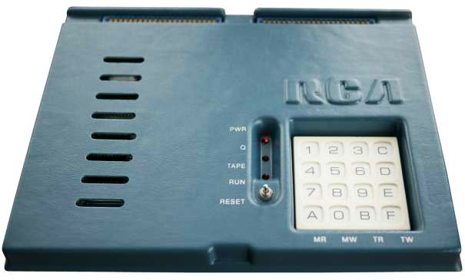
Chip8 Emulator
Implementation
Example keypad:
https://vintagecomputer.com/rca-cosmac-vip.html

Slide 72
Chip8 Emulator
Implementation
Emulators State Machine Cycle
Fetch Instruction
Decode Instruction
Execute Instruction
Repeat until interrupt signal is received

Slide 73
Finally… time for some code!

Slide 74
Additional Information
Code, Sources and additional reading
Source Code/Slides: https://github.com/MikeRavenelle/CSharpChip8
Sources:
https://tobiasvl.github.io/blog/write-a-chip-8-emulator/
https://multigesture.net/articles/how-to-write-an-emulator-chip-8-interpreter/

Slide 75
Additional Information
Continued Reading
https://dolphin-emu.org/blog/
https://pcsx2.net/blog/
https://www.libretro.com/index.php/category/blog/

